Slide 1
Xero 4. Financial Data Entry 5. Bank Feeds & Reconciliations
By Team 1
Noel Sam Routhu (QA Manager)
Hanith Atluri (Software Tester)
Matt Borowskii (QA Analyst)
Meghana Gudipati (Business Analyst)
Bavana Kolasani (Software Tester)
Yash Vora (Software Tester)
Jingsi Hu (Software Tester)
Sashank Allugunti (Software Tester)

Slide 2
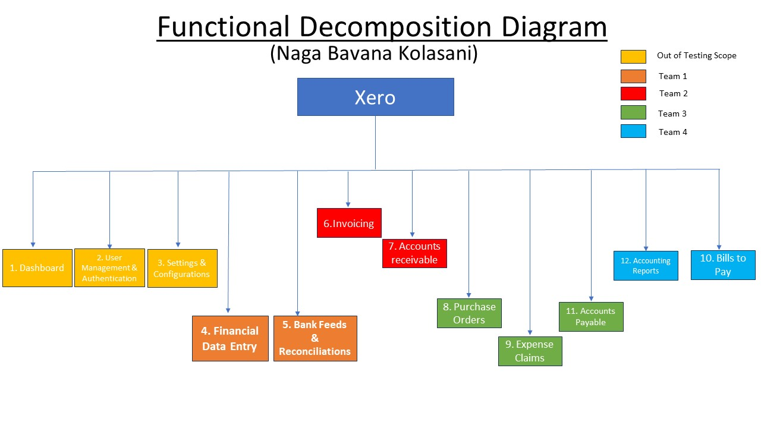
FUNCTIONAL DECOMPOSITION DIAGRAM

Slide 3
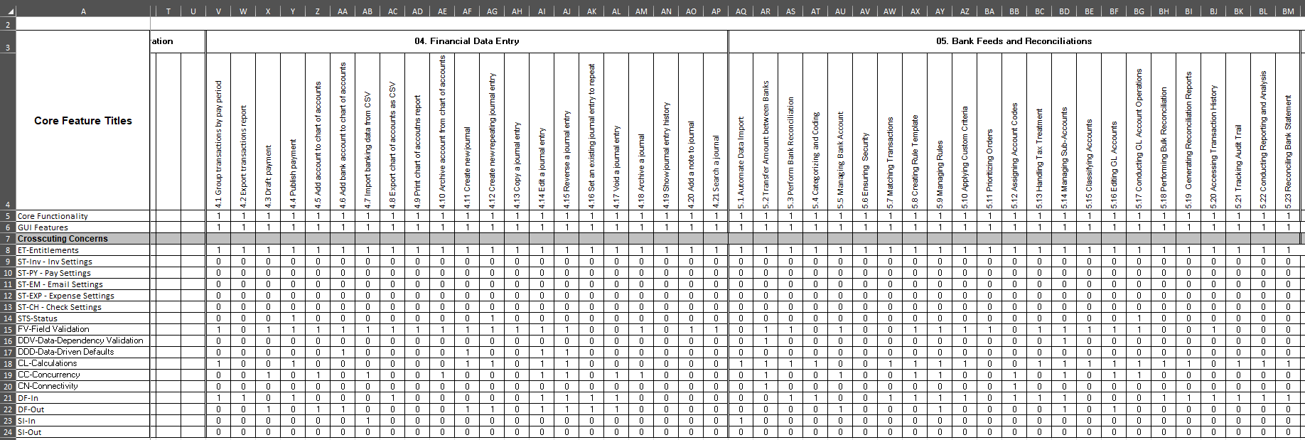
RCT
Hanith Alturi

Slide 4
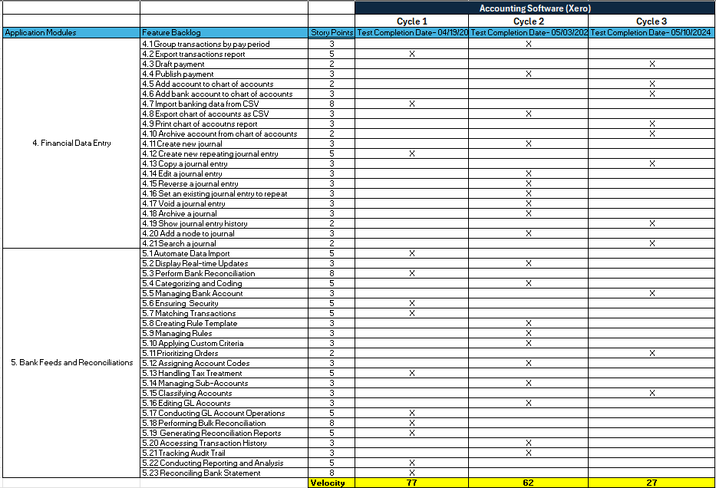
Testing RoadMap
Jingsi Hu

Slide 5
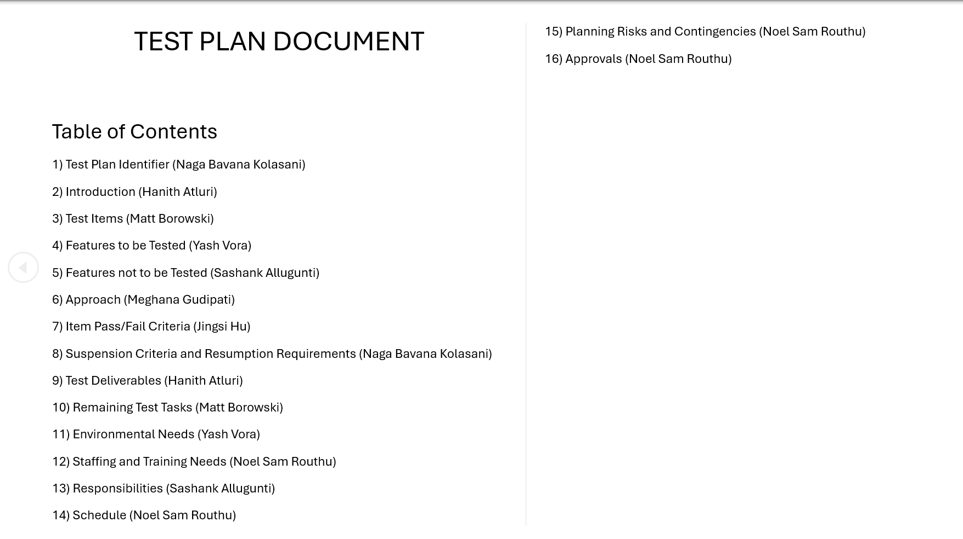
Testing Plan
Matt Borowski

Slide 6
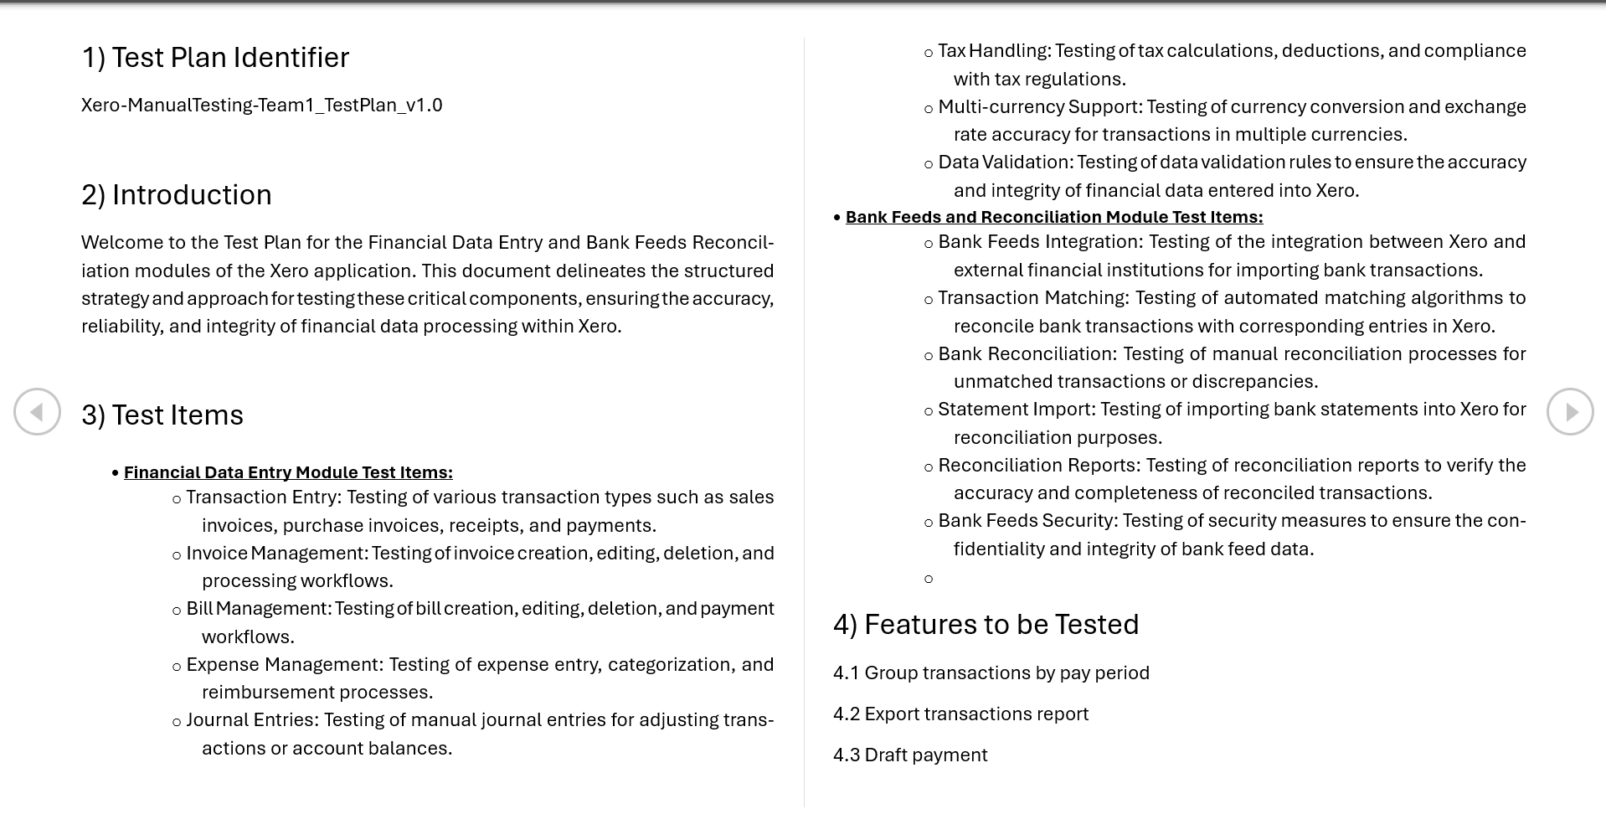
Testing Plan
Matt Borowski

Slide 7
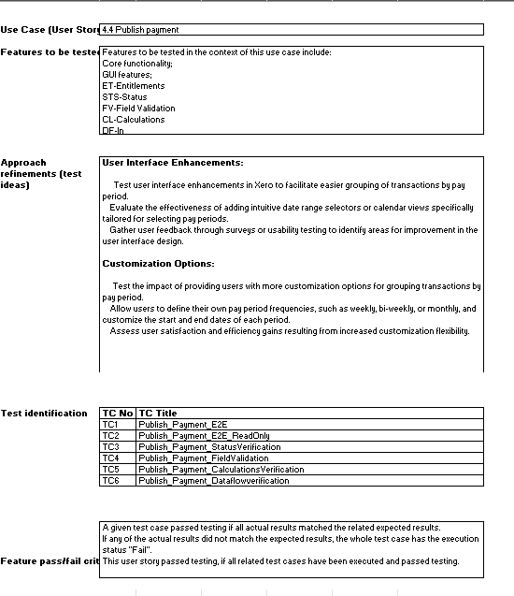
Testing Design Specification
Yash Vora

Slide 8
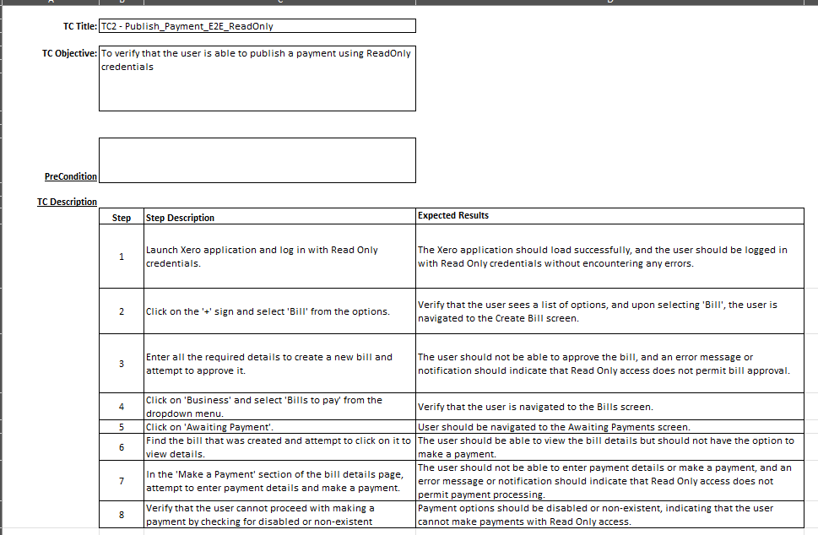
Testing Case Specification
Meghana Gudipati

Slide 9
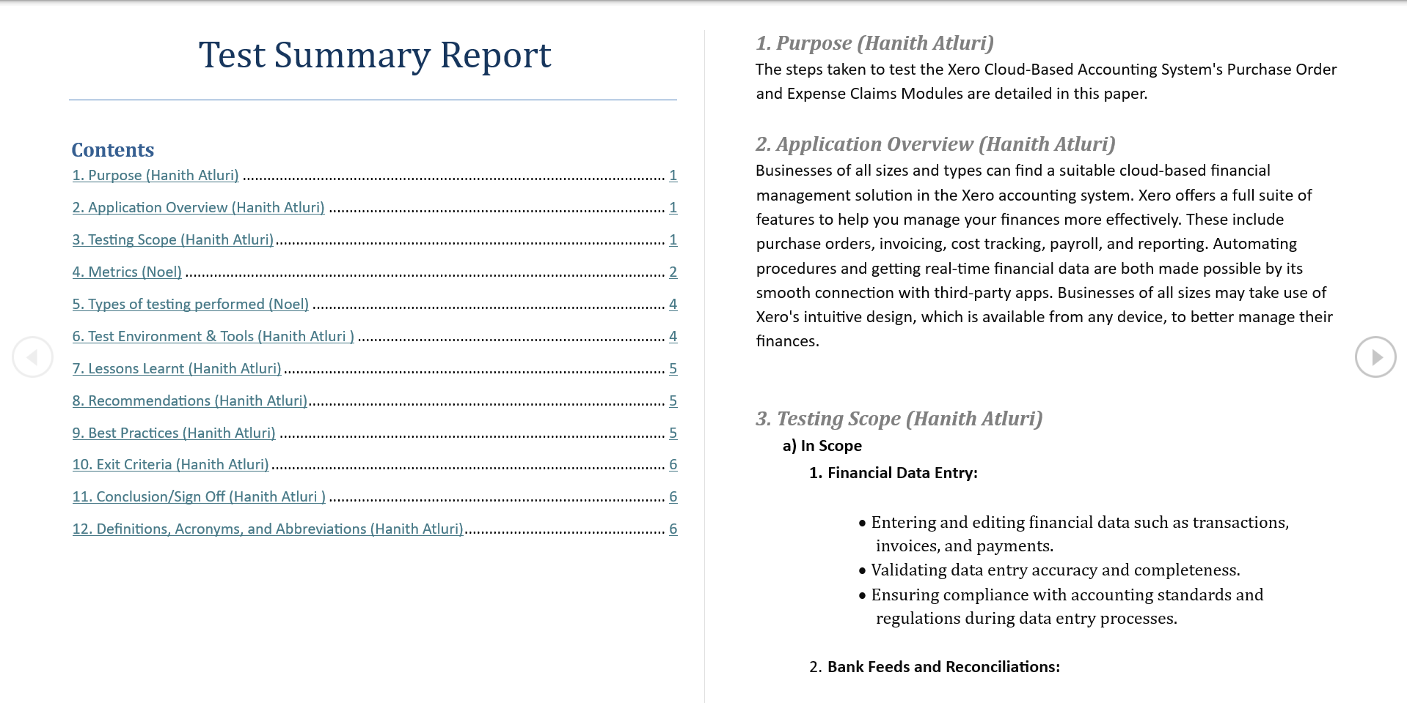
Test Summary Report
Sashank Allugunti

Slide 10
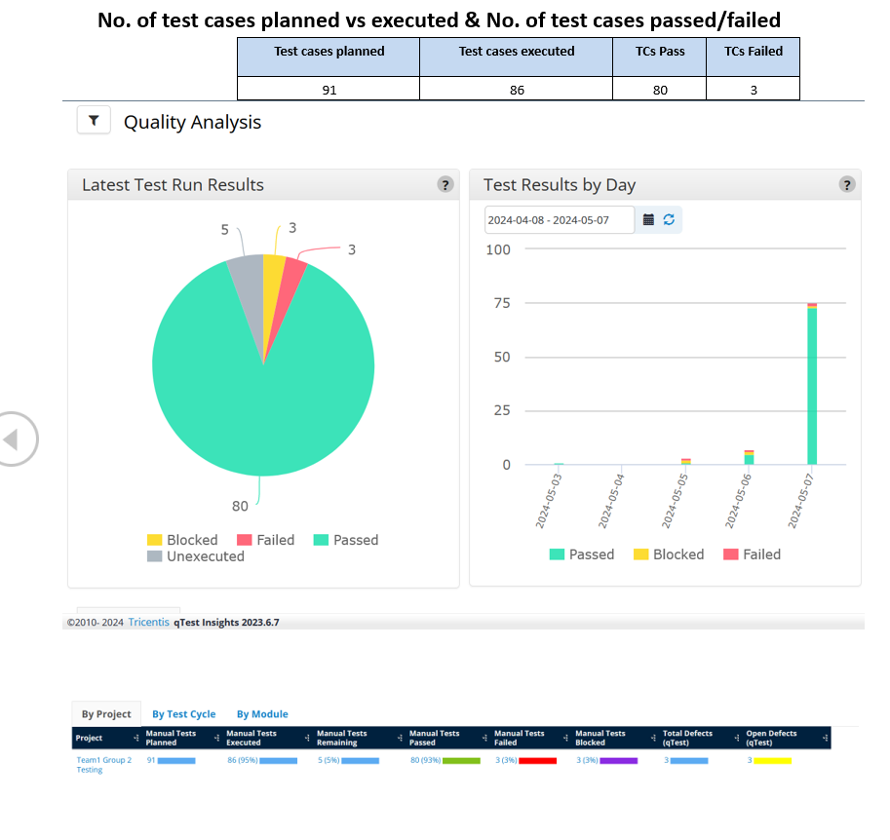
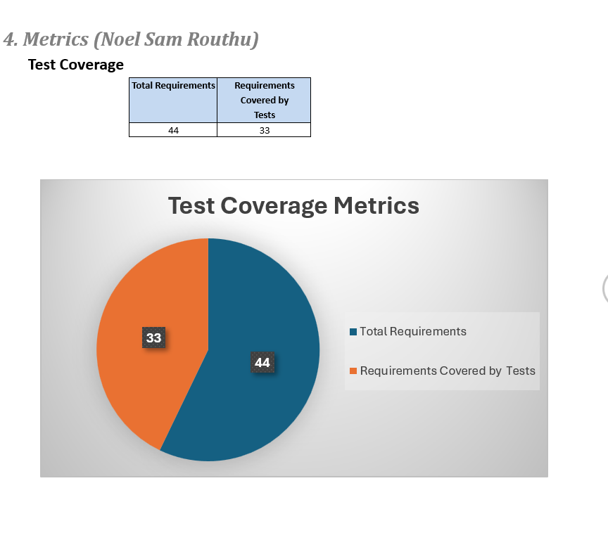
Test Summary Report
Sashank Allugunti

Slide 11

Application Demo – Record
Noel Sam Routhu

Slide 12


GitHub Repository
https://github.com/noelsamrouthu/CS631G_SoftwareVerification_Team1_Repo

Slide 13
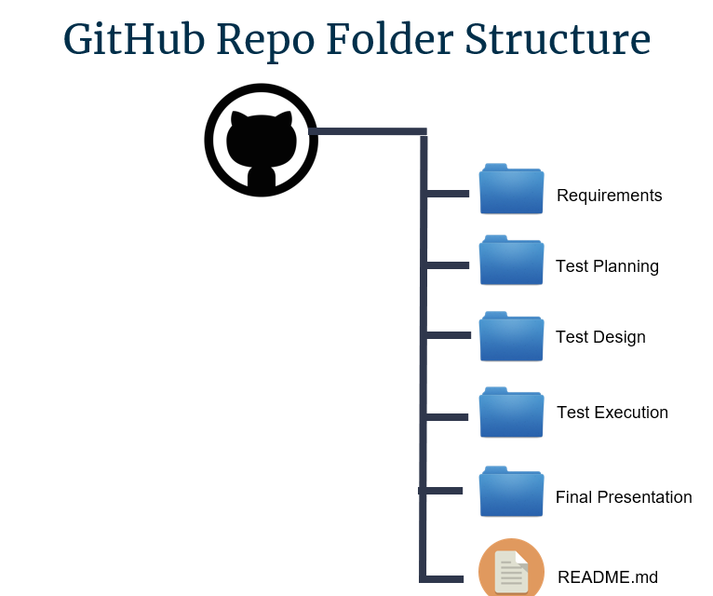
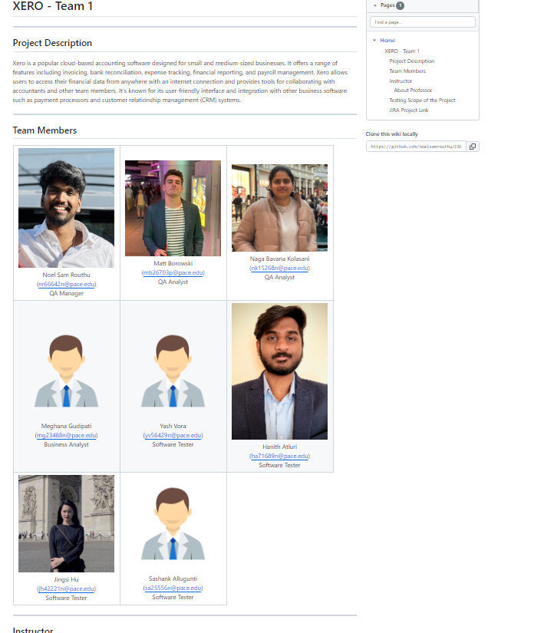
GitHub Repository

Slide 14
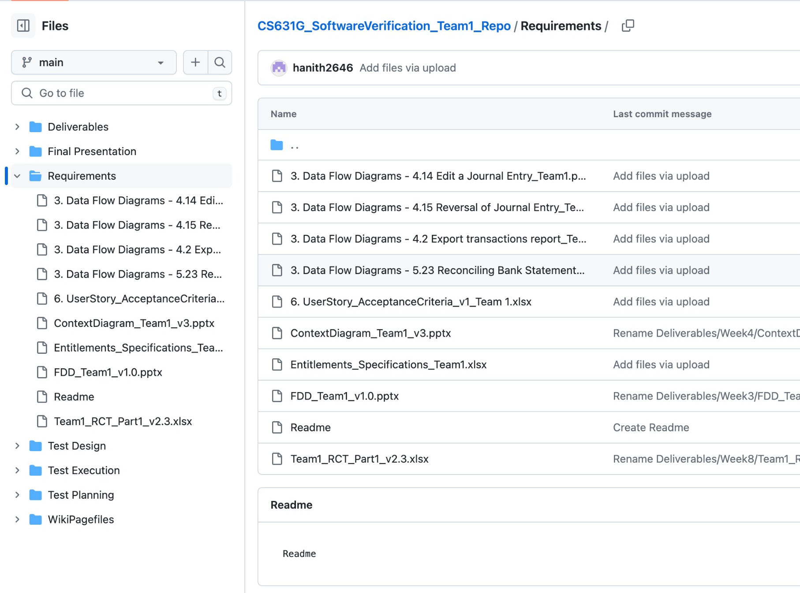
GitHub Repository

Slide 15
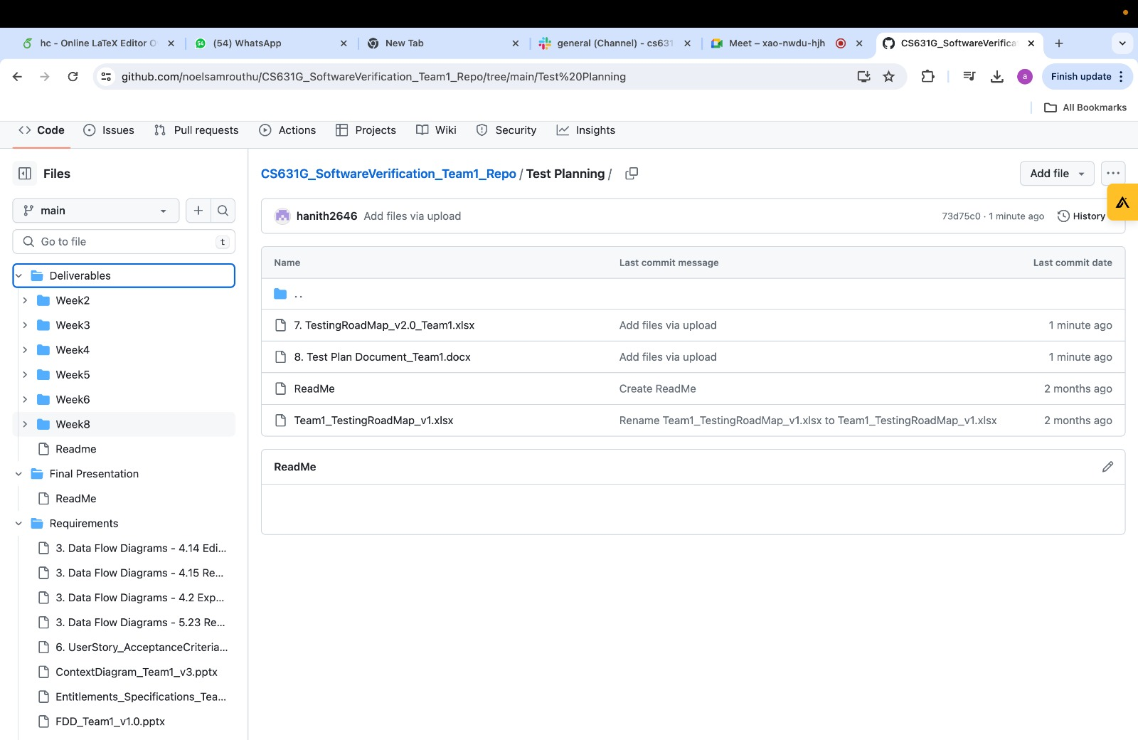
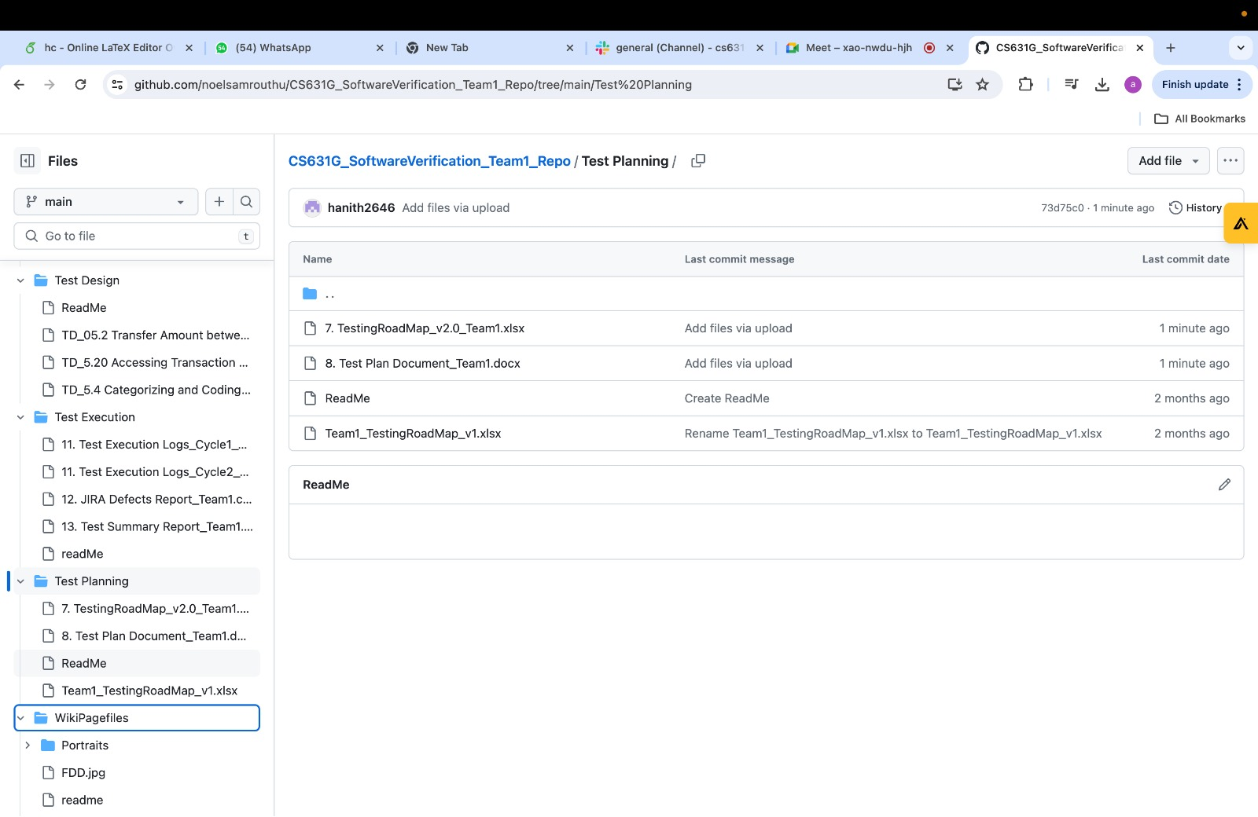
GitHub Repository

Slide 16
Thank you
Team 1

